Slide 1



NEW METHOD FOR NATURAL FREQUENCY AND DAMPING RATIO DETERMINATION VIA BUMP ROAD EXCITATION
VIETNAM NATIONAL UNIVERSITY HO CHI MINH CITY
HO CHI MINH CITY UNIVERSITY OF TECHNOLOGY
FACULTY OF TRANSPORTATION ENGINEERING
DEPARTMENT OF AUTOMOTIVE AND ENGINE
GRADUATION THESIS
Student: Do Thai An – ID: 1652005
Instructor: Dr. Tran Huu Nhan
Date: May 26th, 2022

Slide 2
CONTENTS
INTRODUCTION
THEORETICAL BASIS
MODEL DESCRIPTIONS
CALCULATION FLOW
RESULTS AND DISSCUSSION
CONCLUSIONS AND FUTURE WORKS
1.1 Suspension system
1.2 Suspension components
1.3 Analysis factors
1.4 Thesis objective & limitation

Slide 3
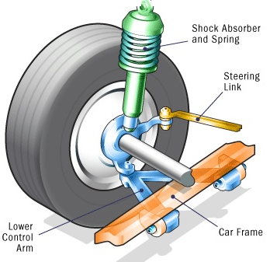
1.1 Suspension system
Suspension system: Connects a vehicle to its wheels and allows relative motion
Function of suspension:
Carry the car and its weight
Maintain correct wheel alignment
Control the vehicle’s direction of travel
Keep the tires in contact with the road
Reduce the effect of shock forces

Slide 4
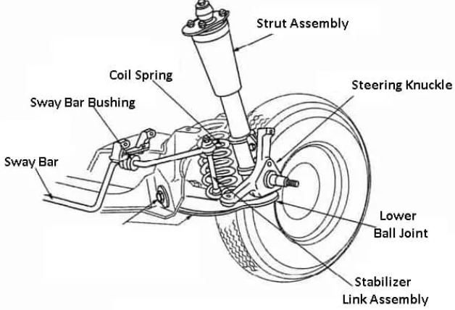
1.2 Suspension components
Guiding elements:
Control arms, links
Struts
Leaf springs
Force elements:
Coil spring, torsion bar, air spring, leaf spring
Anti-roll bar, anti-sway bar or stabilizer
Damper
Bushings, hydro-mounts
Tires
Notes:
Coil springs, torsion bars, and leaf springs absorb additional load by compressing. Thus, the ride height depends on the loading condition. Air springs are rubber cylinders filled with compressed air

Slide 5
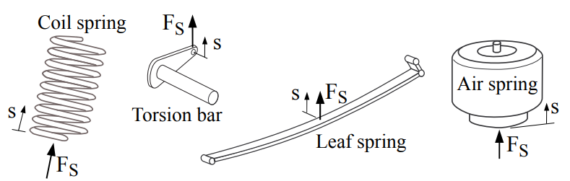
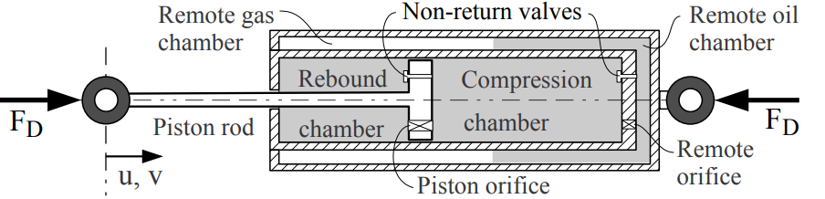
1.2 Suspension components
Elastic
Damping
Notes:
Coil springs, torsion bars, and leaf springs absorb additional load by compressing. Thus, the ride height depends on the loading condition. Air springs are rubber cylinders filled with compressed air

Slide 6
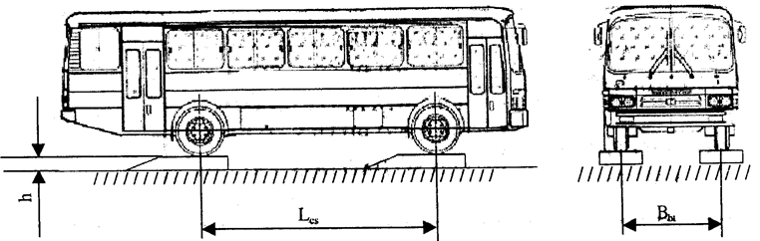
1.3 Analysis factors
1. Natural frequency and damping ratio determination via bump road excitation
=> new method for determination of natural frequency and damping ratio alternative to the old method (22TCN 336:2006)

Slide 7
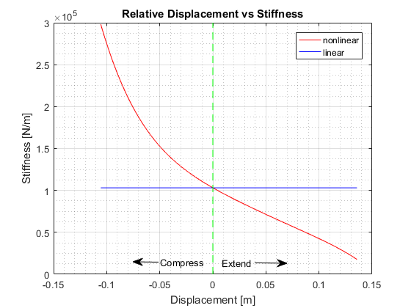
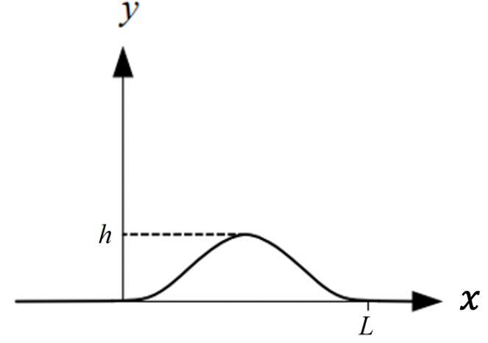
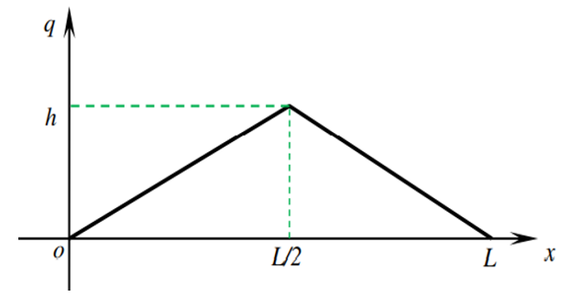
1.3 Analysis factors
2. Suspension characteristics
Compare between air spring and leaf spring
Compare between different input road excitation

Slide 8
1.4 Thesis objective & scope
Investigate the effects of leaf spring – air spring parameters and road profiles on ride comfort and stability.
Investigate the appropriate road profile, apply it to 22TCN 336:2006 industrial standard
Use quarter-car 2 DOF models, take system parameters of Primas bus as basis.
Hypothesis: linear suspension system (constant spring stiffness) and non-linear suspension system (variability spring stiffness, constant damping coefficient), no seat suspension.
Scope: IRC and GB/T road profiles, vehicle speed in range of 0 – 100 km/h, 70 PSI air spring pressure.

Slide 9
CONTENTS
INTRODUCTION
THEORETICAL BASIS
MODEL DESCRIPTIONS
CALCULATION FLOW
RESULTS AND DISSCUSSION
CONCLUSIONS AND FUTURE WORKS
2.1 Suspension models
2.2 Natural frequency & damping ratio
2.3 IRC – GB/T road profile
2.4 Evaluation indexes
2.5 Natural frequency and damping ratio determination

Slide 10
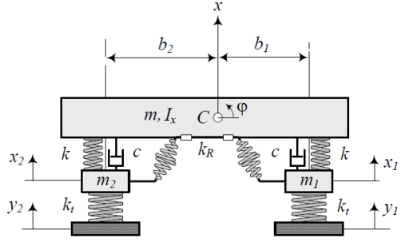
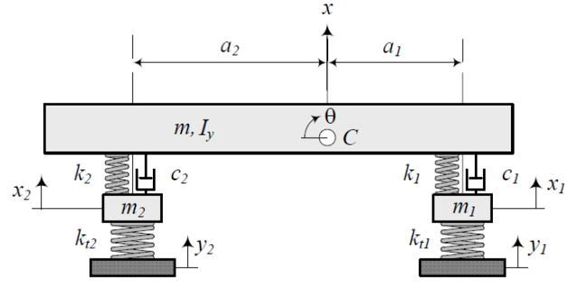
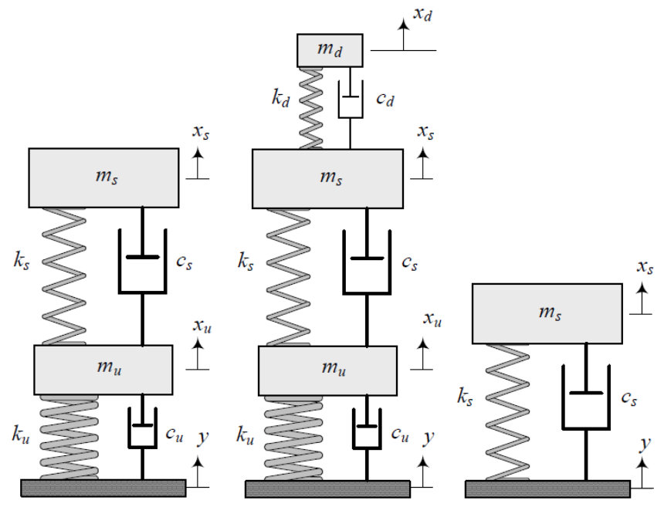
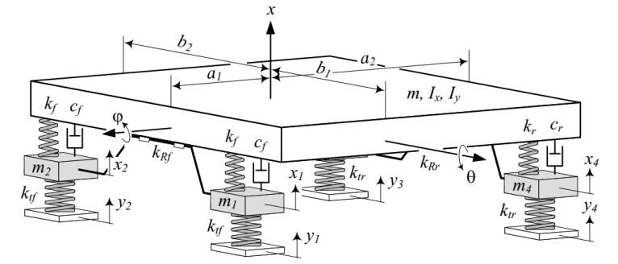
2.1 Suspension models
Vertical motions
Rotational motions
Figure 2.2: Model of car vibration in the horizontal plane, 4DOF
Figure 2.3: Model of car vibration in the vertical plane, 4DOF
Figure 2.1: Quarter-car models (2,3,1 DOF)
Figure 2.4: Model of car vibration 7DOF
Notes:
Study vertical movement
Study vertical/pitch/roll movements

Slide 11
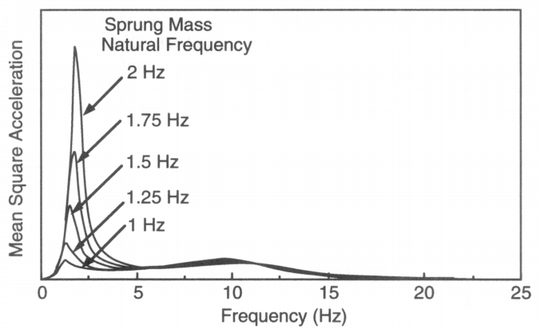
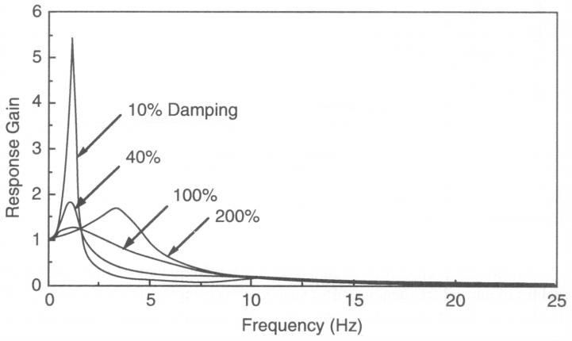
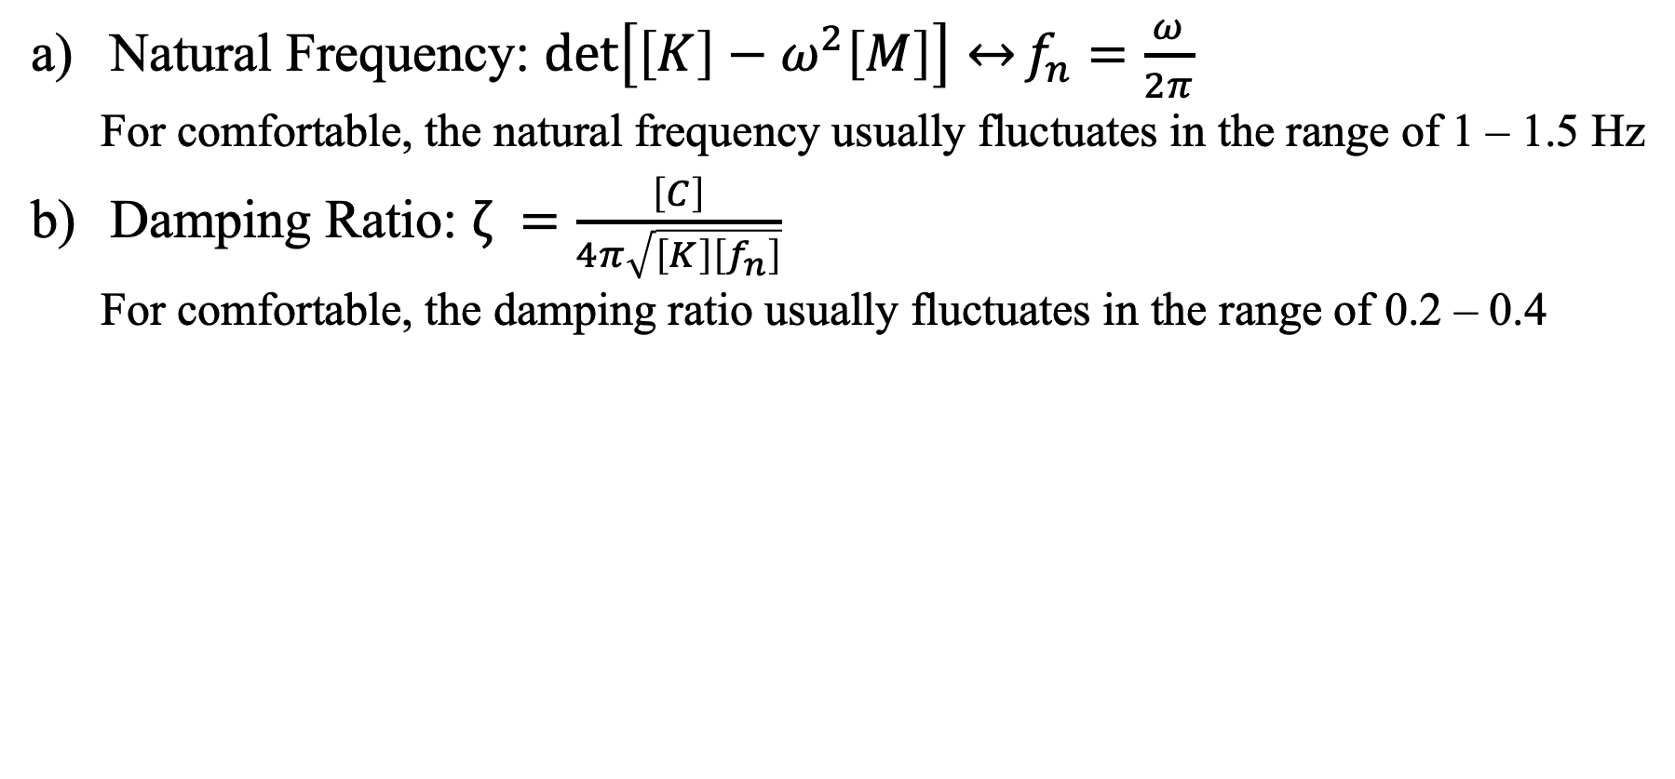
2.2 Natural frequency & damping ratio
Natural Frequency: ${\det\left[\left[K\right]−ω^{2}\left[M\right]\right]↔f}_{n}=\frac{ω}{2π}$
For comfortable, the natural frequency usually fluctuates in the range of 1 – 1.5 Hz
Damping Ratio: $ζ =\frac{\left[C\right]}{4π\sqrt{\left[K\right]\left[f_{n}\right]}}$
For comfortable, the damping ratio usually fluctuates in the range of 0.2 – 0.4
Figure 2.5: Effect of natural frequency
Figure 2.6: Effect of damping ratio
Notes:
Để dễ cho việc nghiên cứu, ta sẽ suy hết về dạng fn và zeta thay vì độ cứng và damping coefficient

Slide 12
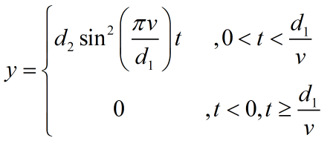
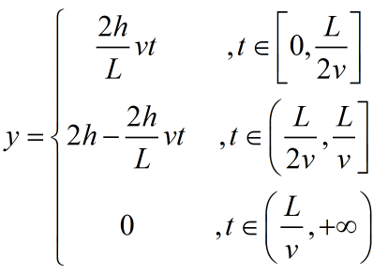
2.3 IRC – GB-T road profile
IRC – Indian Road Congress
GB/T - standard GB/T 4970-2009, China

Slide 13
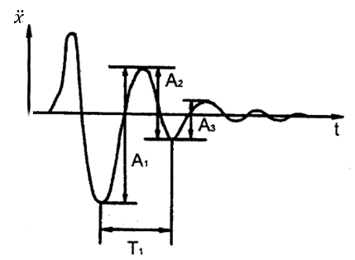
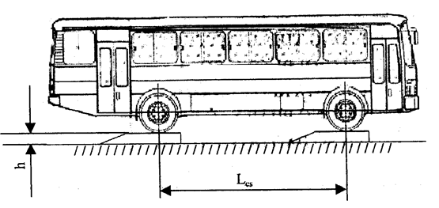
2.4 Natural frequency and damping ratio determination
22TCN 336:2006 Standard method: (Minister of Transport)
Create vertical oscillation
Press down a half of car
Lift a half of car
Record the received oscillation signal
Body acceleration signal
Body displacement signal
Processing test results
Drawbacks
Dangerous while testing
Complicated
Costs for testing components

Slide 14
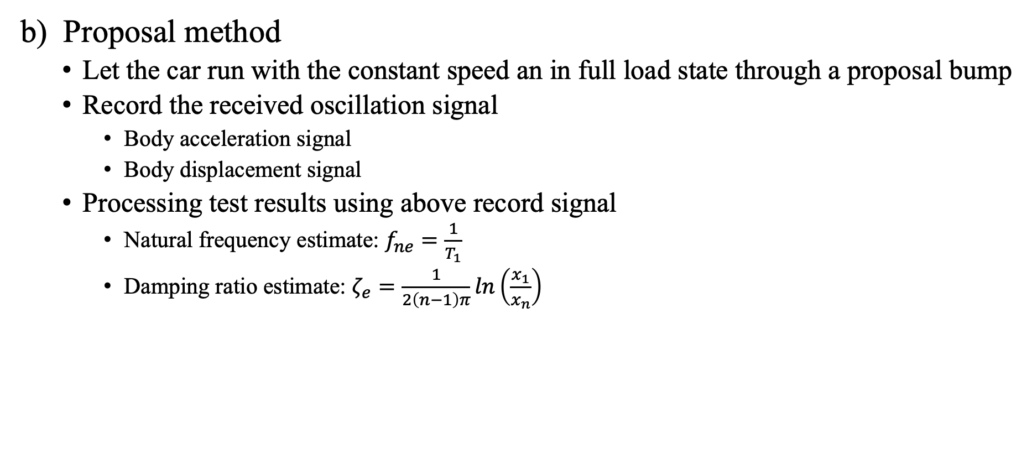
2.4 Natural frequency and damping ratio determination
b) Proposal method
Let the car run with the constant speed an in full load state through a proposal bump
Record the received oscillation signal
Body acceleration signal
Body displacement signal
Processing test results using above record signal
Natural frequency estimate: $f_{ne}=\frac{1}{T_{1}}$
Damping ratio estimate: $ζ_{e}=\frac{1}{2\left(n−1\right)π}ln\left(\frac{x_{1}}{x_{n}}\right)$

Slide 15
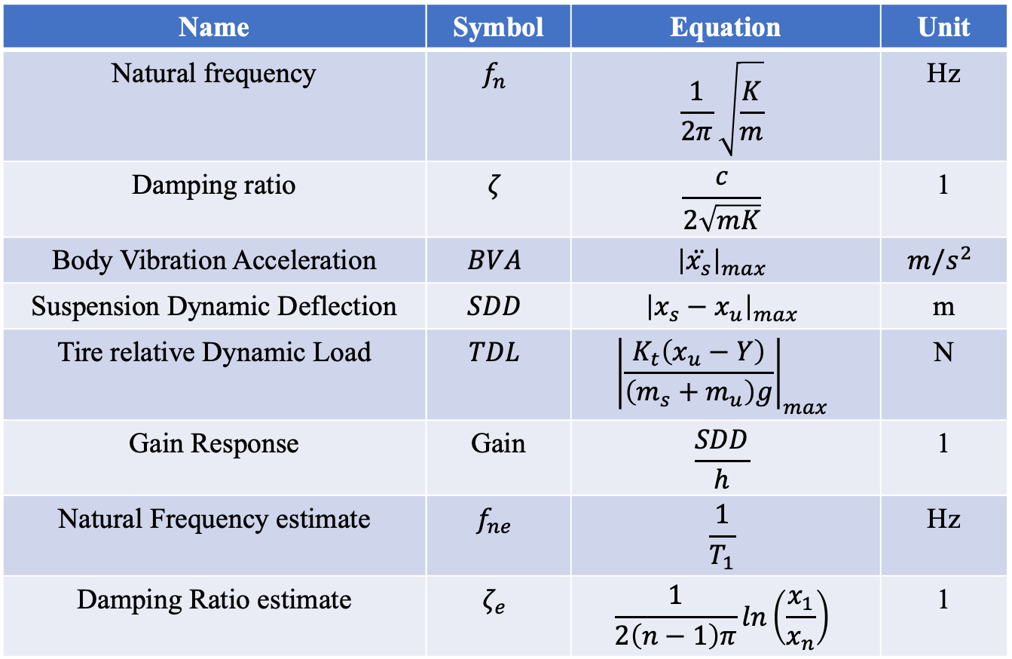
2.5 Evaluation indexes
Name | Symbol | Equation | Unit
Natural frequency | $$f_{n}$$ | $$\frac{1}{2π}\sqrt{\frac{K}{m}}$$ | Hz
Damping ratio | $$ζ$$ | $$\frac{c}{2\sqrt{mK}}$$ | 1
Body Vibration Acceleration | $$BVA$$ | $${\left|\ddot{x_{s}}\right|}_{max}$$ | $$m/s^{2}$$
Suspension Dynamic Deflection | $$SDD$$ | $${\left|x_{s}−x_{u}\right|}_{max}$$ | m
Tire relative Dynamic Load | $$TDL$$ | $${\left|\frac{K_{t}\left(x_{u}−Y\right)}{\left(m_{s}+m_{u}\right)g}\right|}_{max}$$ | N
Gain Response | Gain | $$\frac{SDD}{h}$$ | 1
Natural Frequency estimate | $$f_{ne}$$ | $$\frac{1}{T_{1}}$$ | Hz
Damping Ratio estimate | $$ζ_{e}$$ | $$\frac{1}{2\left(n−1\right)π}ln\left(\frac{x_{1}}{x_{n}}\right)$$ | 1

Slide 16
CONTENTS
INTRODUCTION
THEORETICAL BASIS
MODEL DESCRIPTIONS
CALCULATION FLOW
RESULTS AND DISSCUSSION
CONCLUSIONS AND FUTURE WORKS
3.1 Models
3.2 Air spring parameters
3.3 Road parameters
3.4 Model parameters

Slide 17
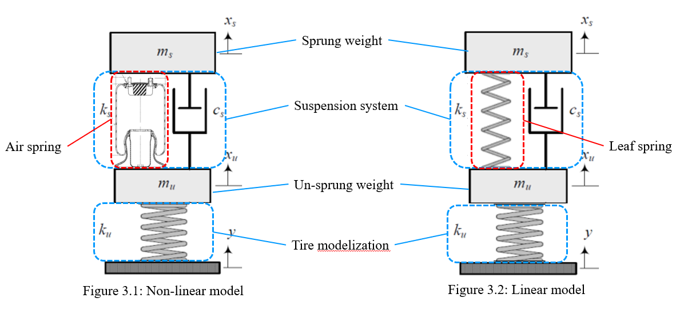
3.1 Models

Slide 18
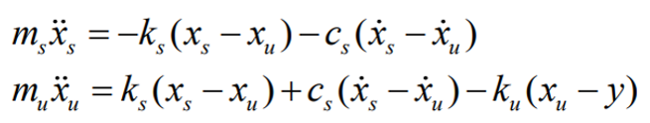
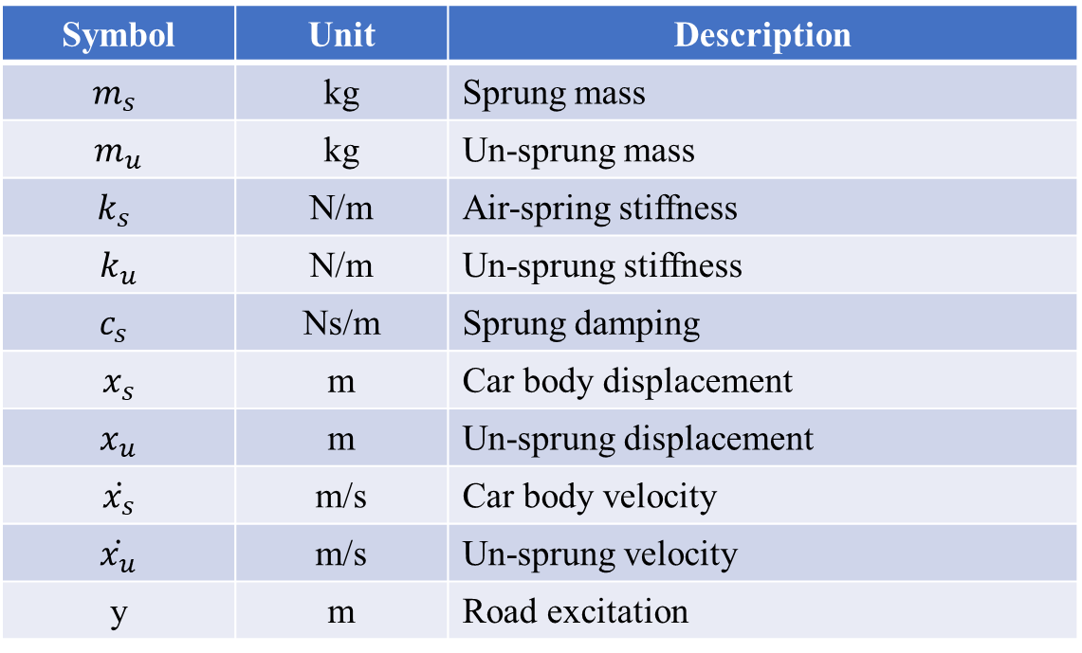
3.1 Models
ODE Equation:
Symbol | Unit | Description
$$m_{s}$$ | kg | Sprung mass
$$m_{u}$$ | kg | Un-sprung mass
$$k_{s}$$ | N/m | Air-spring stiffness
$$k_{u}$$ | N/m | Un-sprung stiffness
$$c_{s}$$ | Ns/m | Sprung damping
$$x_{s}$$ | m | Car body displacement
$$x_{u}$$ | m | Un-sprung displacement
$$\dot{x_{s}}$$ | m/s | Car body velocity
$$\dot{x_{u}}$$ | m/s | Un-sprung velocity
y | m | Road excitation

Slide 19
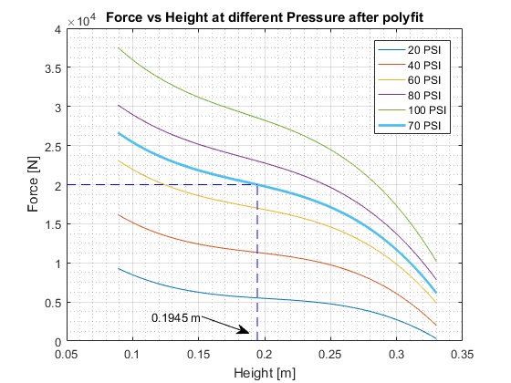
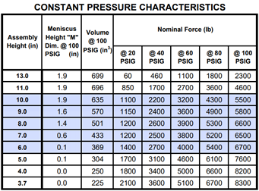
3.2 Air spring parameters
Air spring 1R11-028 – GoodYear product

Slide 20
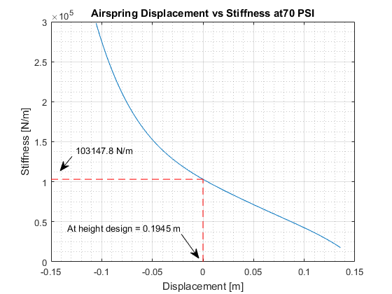
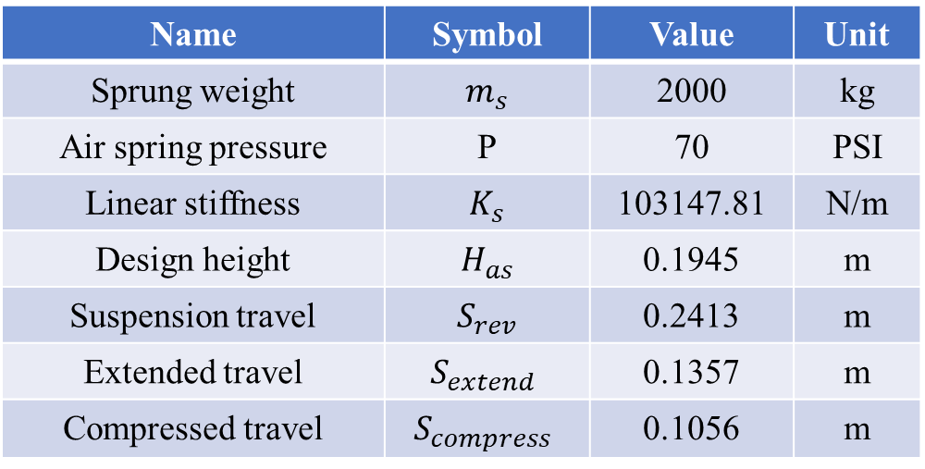
3.2 Air spring parameters
Name | Symbol | Value | Unit
Sprung weight | $$m_{s}$$ | 2000 | kg
Air spring pressure | P | 70 | PSI
Linear stiffness | $$K_{s}$$ | 103147.81 | N/m
Design height | $$H_{as}$$ | 0.1945 | m
Suspension travel | $$S_{rev}$$ | 0.2413 | m
Extended travel | $$S_{extend}$$ | 0.1357 | m
Compressed travel | $$S_{compress}$$ | 0.1056 | m

Slide 21
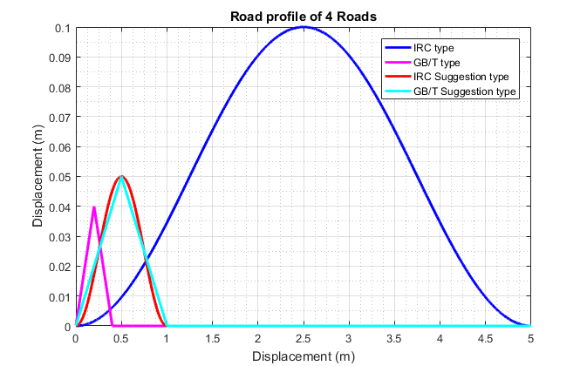
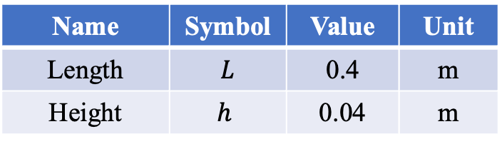
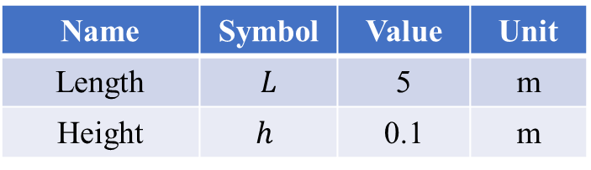
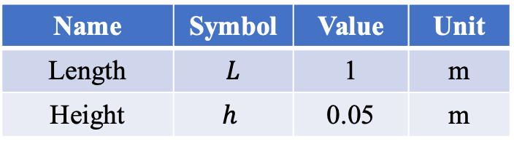
3.3 Road parameters
IRC Road
GB/T Road
IRC – GB/T suggestion
Name | Symbol | Value | Unit
Length | $$L$$ | 5 | m
Height | $$h$$ | 0.1 | m
Name | Symbol | Value | Unit
Length | $$L$$ | 0.4 | m
Height | $$h$$ | 0.04 | m
Name | Symbol | Value | Unit
Length | $$L$$ | 1 | m
Height | $$h$$ | 0.05 | m

Slide 22
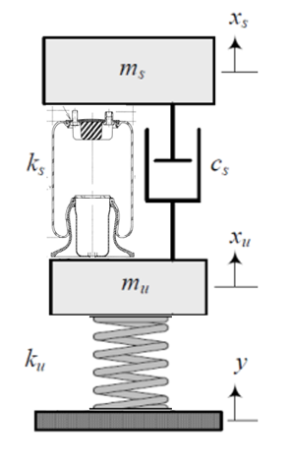
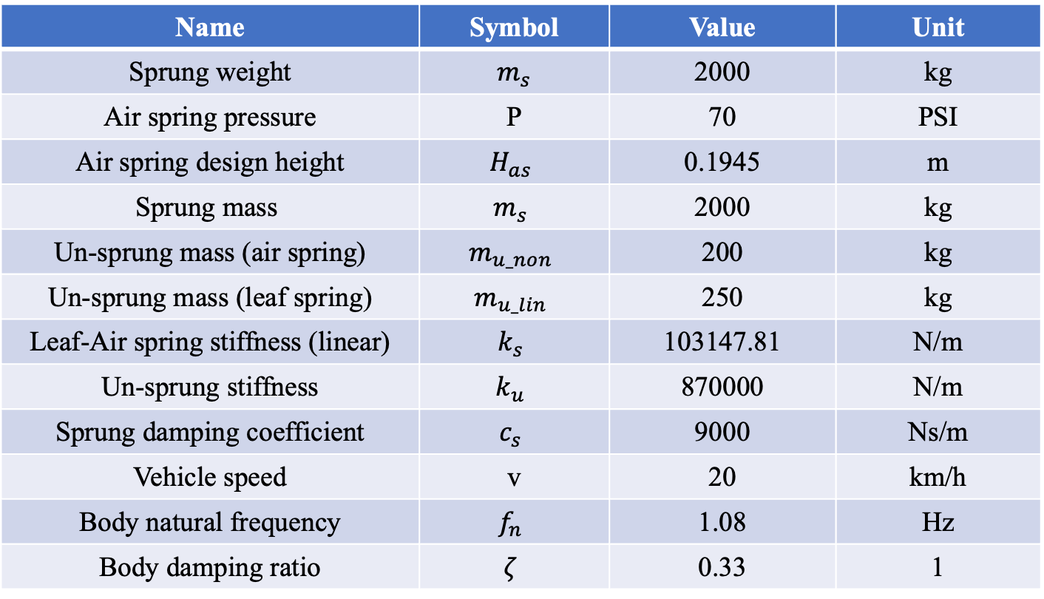
3.4 Model parameters
Name | Symbol | Value | Unit
Sprung weight | $$m_{s}$$ | 2000 | kg
Air spring pressure | P | 70 | PSI
Air spring design height | $$H_{as}$$ | 0.1945 | m
$$\text{Sprung} \text{mass}$$ | $$m_{s}$$ | 2000 | kg
Un-sprung mass (air spring) | $$m_{u_non}$$ | 200 | kg
Un-sprung mass (leaf spring) | $$m_{u_lin}$$ | 250 | kg
Leaf-Air spring stiffness (linear) | $$k_{s}$$ | 103147.81 | N/m
Un-sprung stiffness | $$k_{u}$$ | 870000 | N/m
Sprung damping coefficient | $$c_{s}$$ | 9000 | Ns/m
Vehicle speed | v | 20 | km/h
Body natural frequency | $$f_{n}$$ | 1.08 | Hz
Body damping ratio | $$ζ$$ | 0.33 | 1

Slide 23
CONTENTS
INTRODUCTION
THEORETICAL BASIS
MODEL DESCRIPTIONS
CALCULATION FLOW
RESULTS AND DISSCUSSION
CONCLUSIONS AND FUTURE WORKS

Slide 24

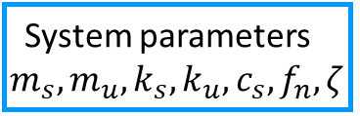
4. CALCULATION FLOW
Input GB/T road profiles
Time response calculation (ODE45 solver)
Frequency response
System parameters $m_{s},m_{u},k_{s},k_{u},c_{s}, f_{n},ζ$
Compare stability characteristics
Time response calculation (ODE45 solver)
Frequency response
Input IRC road profiles
Evaluate the proposal road testing
Evaluate $f_{n}, ζ$
passed
Input proposal road profiles
Time response calculation (ODE45 solver)
Conclusion
failed

Slide 25
CONTENTS
INTRODUCTION
THEORETICAL BASIS
MODEL DESCRIPTION
CALCULATION FLOW
RESULTS AND DISSCUSSION
CONCLUSIONS AND FUTURE WORKS
5.1 Get specific car speed
5.2 Natural frequency estimate results
5.3 Damping ratio estimate result

Slide 26
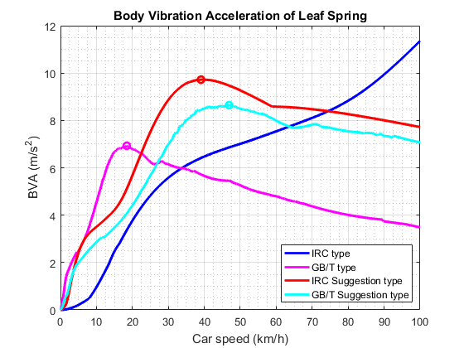
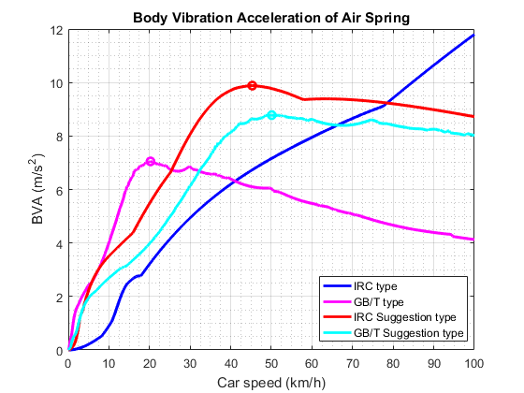
5.1 Get specific car speed
Consider Body Vibration Acceleration of each road type and each suspension type => Find car velocity at the largest BVA value.
Highest peak of BVA is for IRC road type, however it’s exceeded 100km/h
=> Reject IRC type
These velocity at maximum acceleration applied to calculate and compare the different error of 4 road types in 2 case leaf and air spring
Type | Unit | Car speed
GB/T | Km/h | 18.44
GB/T suggestion | Km/h | 39.08
IRC suggestion | Km/h | 46.89
Type | Unit | Car speed
IRC suggestion | Km/h | 20.24
GB/T suggestion | Km/h | 45.29
GB/T | Km/h | 50.10

Slide 27
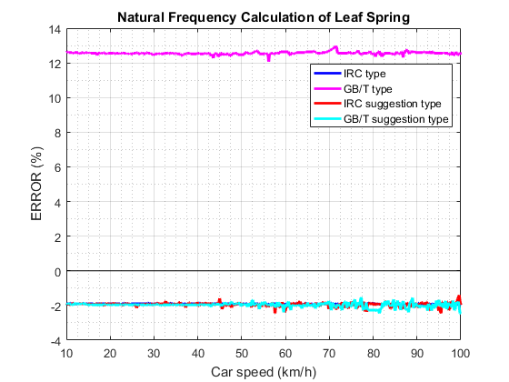
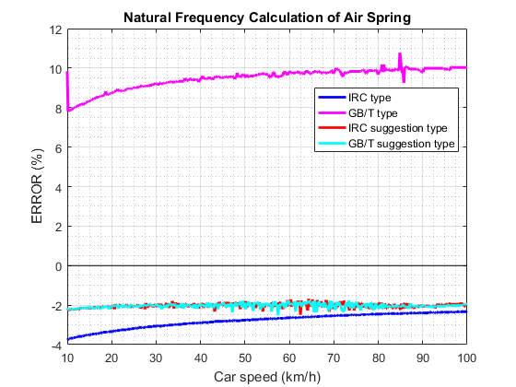
5.1 Natural Frequency estimate results
In the change of car speed, the percentage of error is the same for different type of road type
- There is the increase error of GB/T and the decrease error of IRC type when the car speed increase.
- For both suggestion type is slightly decrease.
The worst case for both linear and non-linear spring is GB/T type
The percent of error in GB/T is largest compare with the remain road type.
There are almost the same the percentage of error in leaf and air spring in 2 suggestion type.

Slide 28
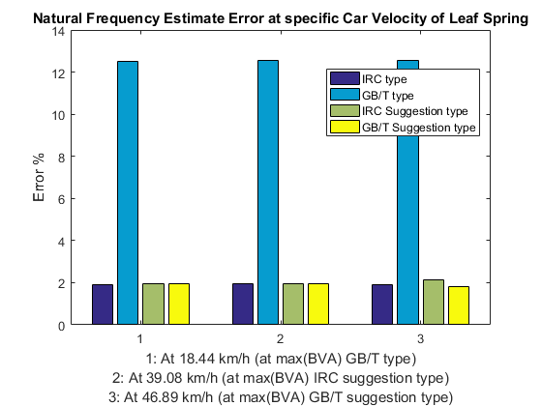
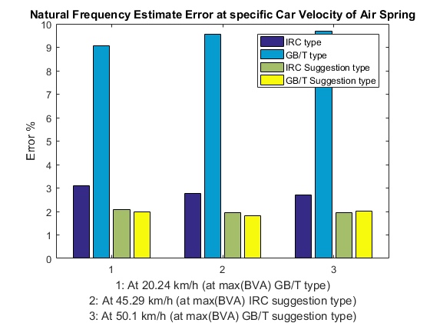
5.2 Natural Frequency estimate results
At the speed with maximum acceleration of GB/T suggestion type, the error for natural frequency is the smallest
Both types of suggested parameters give almost the smallest error (about 2%).
Possible to choose parameter of suggest type and can be used for all types of roads when surveying natural frequencies

Slide 29
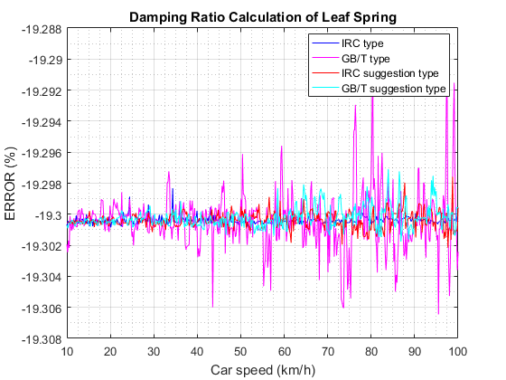
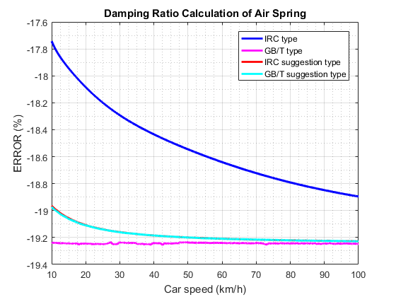
5.2 Damping Ratio estimate results
The % of error are the same in the change of car speed for 4 type road
- In the GB/T type, there is almost no change in the different car speed.
- In 3 others type, the % of error increase in the increase of car speed
Overall error is too large (greater than 17%)

Slide 30
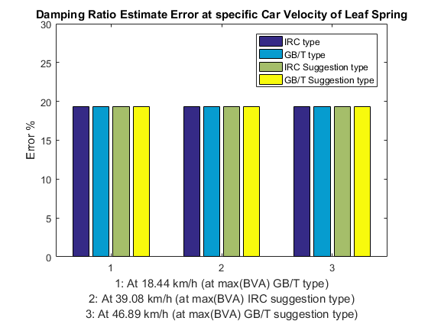
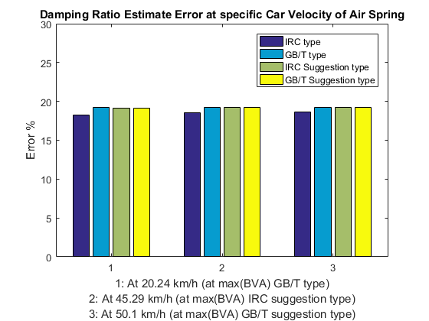
5.3 Damping Ratio estimate results
These percentage of error are all larger than 15%

Slide 31
6. CONCLUSIONS AND FUTURE WORKS

Slide 32
THANK YOU FOR LISTENING

Slide 36
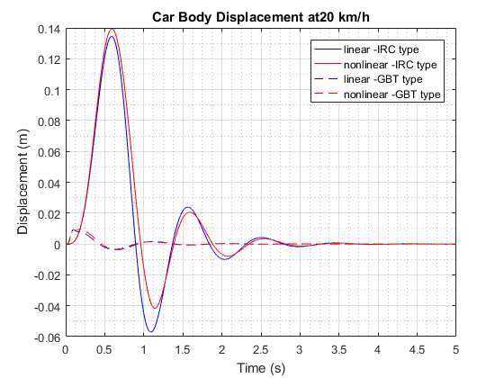
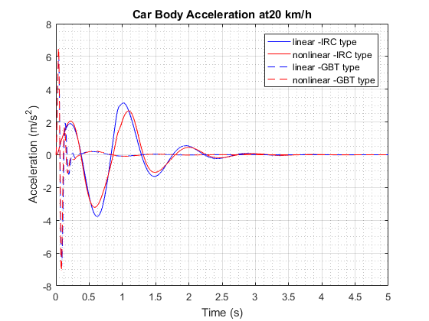
5.1 Time response results

Slide 37
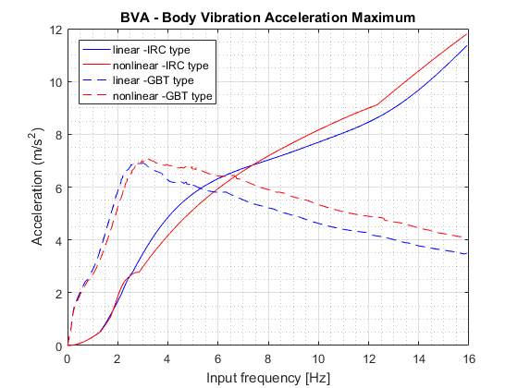
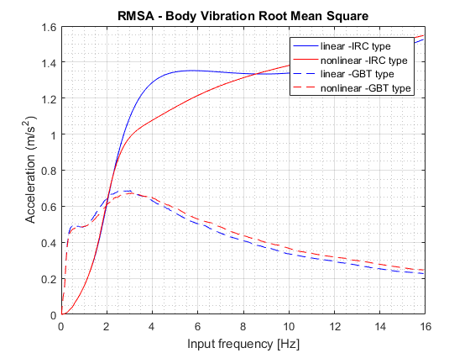
5.2 Frequency response results

Slide 38
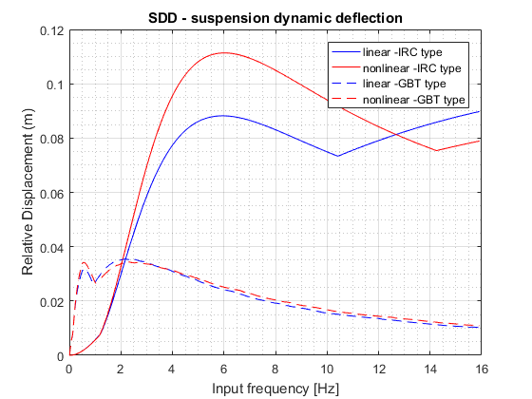

5.2 Frequency response results

Slide 39

5.3 Natural frequency and Damping ratio determination

Slide 40
5.3 Natural frequency and Damping ratio determination

Slide 41
6. CONCLUSIONS
50% progress
Change topic’s name to “DYNAMIC ANALYSIS OF THE PRIMAS BUS USING 2DOF MODEL WITH AIR SPRING AND RESEARCH NEW METHOD FOR NATURAL FREQUENCY AND DAMPING RATIO DETERMINATION VIA BUMP ROAD EXCITATION”

Slide 42
THANK YOU FOR LISTENING

Slide 45
CONTENTS
INTRODUCTION
THEORETICAL BASIS
MODEL DESCRIPTIONS
CALCULATION FLOW
RESULTS AND DISSCUSSION
CONCLUSIONS AND FUTURE WORKS

Slide 48
6. CONCLUSIONS
Conclusion
Ride comfort of T880 truck satisfy comfort requirement on road class A and B under all load cases
Natural frequency increase -> ride comfort decrease
Damping ratio increase -> ride comfort decrease
Calculation results can be used as basis to determine system parameters of suspension in designing process
Future works
Conduct experimental investigation
=> Compare difference between theoretical and practical situations
Modelization of non-linear spring and damper
=> Compare performance between different types of suspension system (air spring, skyhook damper)
Study relationship between ride comfort and handling
=> Utilize 3D model to study rotational motions

Slide 51


3.3 Road parameters
Sprung weight
Suspension system
Air spring
Leaf spring
Un-sprung weight
Tire modelization
Figure 3.1: Non-linear model
Figure 3.2: Linear model

Slide 52


Slide 54
1. INTRODUCTION

Slide 55
2. THEORETICAL BASIS

Slide 56
3. MODEL DESCRIPTIONS

Slide 57
4. CALCULATION FLOW

Slide 58
5. CONCLUSION & FUTURE WORKS

Slide 59
Tổng quan
Thể loại LVTN: Nghiên cứu mô phỏng
Mục tiêu nghiên cứu:
Phương pháp: mô phỏng số trên mô hình 2dof spring mass damper
Công cụ: MATLAB 2018
Thesis scope
Thesis objective
Research methodology
Những bài toán cần giải quyết

Slide 60


Objective/Scope

Slide 61
2. INPUT

Slide 62

2.1. AIR SPRING INPUT
Air spring 1R11-028 – GoodYear product

Slide 63

AIR SPRING Stiffness Calculating
Stiffness formular:

Slide 64

Air spring calculating parameters
Name | Symbol | Value | Unit
Sprung weight | $$m_{s}$$ | 2000 | kg
Air spring pressure | P | 70 | PSI
Linear stiffness | $$K_{s}$$ | 103147.81 | N/m
Design height | $$H_{as}$$ | 0.1945 | m
Suspension travel | $$S_{rev}$$ | 0.2413 | m
Extended travel | $$S_{extend}$$ | 0.1357 | m
Compressed travel | $$S_{compress}$$ | 0.1056 | m

Slide 65
IRC Road INPUT
IRC is the Indian Road profile Congress

Slide 66

Standard GB/T 4970–2009 Road Input
The triangular bump model is created on the basis of the national standard GB/T 4970-2009, China

Slide 67


Calculating model
2DOF spring mass damper model
Symbol | Unit | Description
$$m_{s}$$ | kg | Sprung mass
$$m_{u}$$ | kg | Un-sprung mass
$$k_{s}$$ | N/m | Air-spring stiffness
$$k_{u}$$ | N/m | Un-sprung stiffness
$$c_{s}$$ | Ns/m | Sprung damping
$$x_{s}$$ | m | Car body displacement
$$x_{u}$$ | m | Un-sprung displacement
$$\dot{x_{s}}$$ | m/s | Car body velocity
$$\dot{x_{u}}$$ | m/s | Un-sprung velocity

Slide 68

Input Parameters
Name | Symbol | Value | Unit
Sprung weight | $$m_{s}$$ | 2000 | kg
Air spring pressure | P | 70 | PSI
Design height | $$H_{as}$$ | 0.1945 | m
$$\text{Sprung} \text{mass}$$ | $$m_{s}$$ | 2000 | kg
Un-sprung mass air spring | $$m_{u_non}$$ | 200 | kg
Un-sprung mass leaf spring | $$m_{u_lin}$$ | 250 | kg
Leaf-air spring stiffness | $$k_{s}$$ | 103147.81 | N/m
Un-sprung stiffness | $$k_{u}$$ | 870000 | N/m
Sprung damping | $$c_{s}$$ | 9000 | Ns/m

Slide 69

Calculating and result
Name | Symbol | Value | Unit
IRC Road height | h | 0.1 | m
Air spring pressure | P | 70 | PSI
Design height | $$H_{as}$$ | 0.1945 | m
$$\text{Sprung} \text{mass}$$ | $$m_{s}$$ | 2000 | kg
Un-sprung mass air spring | $$m_{u_non}$$ | 200 | kg
Un-sprung mass leaf spring | $$m_{u_lin}$$ | 250 | kg
Leaf-air spring stiffness | $$k_{s}$$ | 103147.81 | N/m
Un-sprung stiffness | $$k_{u}$$ | 870000 | N/m
Sprung damping | $$c_{s}$$ | 9000 | Ns/m

Slide 70
3. Calculating and results

Slide 71

3.1. Compare IRC – GB/T
Name | Symbol | Value | Unit
IRC Length | L | 0.1 | m
IRC Height | h | 5 | m
GB/T Length | L | 0.4 | m
GB/T Height | h | 0.04 | m

Slide 72

3.1.1. IRC – GB/T Time response result

